Slide 1
SPI PROTOCOL
BY SRAVANTHI
CHIPWEAVE TECHNOLOGIES PVT LMD

Slide 2
Introduction
SPI stands for Serial Peripheral Interface
The SPI module allows a synchronous, serial communication between the MCU and peripheral devices
SPI supports half-duplex and full-duplex serial communication.
SPI is a four-wire communication protocol.
It used for short distance communication between microcontrollers and peripheral devices such as sensors,SD cards and shift registers.
SPI supports 8-bit and 16-bit data frame formats.​
It supports high-speed data transfer, typically up to 10 Mbps.

Slide 3
WHY SPI
Unlike APB (low-bandwidth on-chip peripheral control) and AXI (high-performance, pipelined on-chip system interconnect) which handle complex IP integration within a System-on-Chip (SoC) for different performance needs.
The need for SPI comes from its high speed, full-duplex nature, and lack of address overhead, making it ideal for peripherals needing quick data streaming.
while APB/AXI manage internal SoC communication, with APB for simple control registers and AXI for high-bandwidth data paths.

Slide 4
Features
Master mode and slave mode
Bi-directional mode
Slave select output
Mode fault error flag with CPU interrupt capability
Serial clock with programmable polarity and phase
Control of SPI operation during wait mode

Slide 5
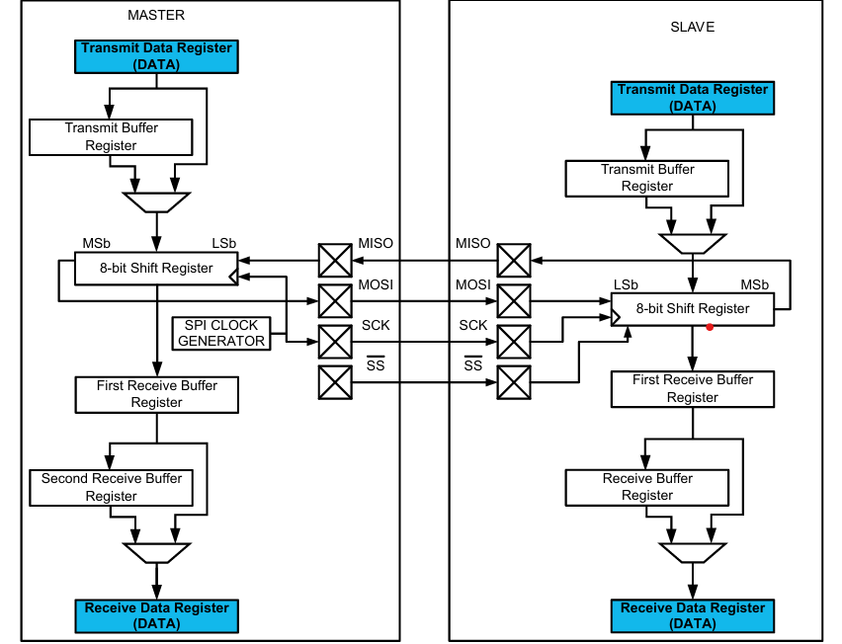
SPI Block Diagram

Slide 6
Working
Master selects the slave​
The master pulls SS (Slave Select) LOW to choose the slave device.​
Master generates the clock​
The master provides SCLK, which synchronizes data transfer between master and slave.​
Data transfer happens on clock edges​
Data is sent from Master to Slave on MOSI and from Slave to Master on MISO, based on clock edges (CPOL/CPHA).​
Communication ends by releasing SS​
After data transfer, the master sets SS HIGH, ending the SPI communication.​

Slide 7
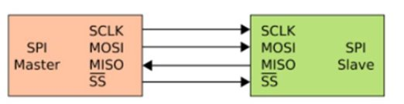
SPI Signals

Slide 8
SPI Signals
MOSI:
This pin is used to transmit data out of the SPI module when it is configured as a Master and receive data when it is configured as Slave.
MISO:
This pin is used to transmit data out of the SPI module when it is configured as a Slave and receive data when it is configured as Master.
SS :
This pin is used to output the select signal from the SPI module to another peripheral with which a data transfer is to take place when its configured as a Masterand its used as an input to receive the slave select signal when the SPI is configured as Slave.
SCK :
This pin is used to output the clock with respect to which the SPI transfers data or receive clock in case of Slave.

Slide 9
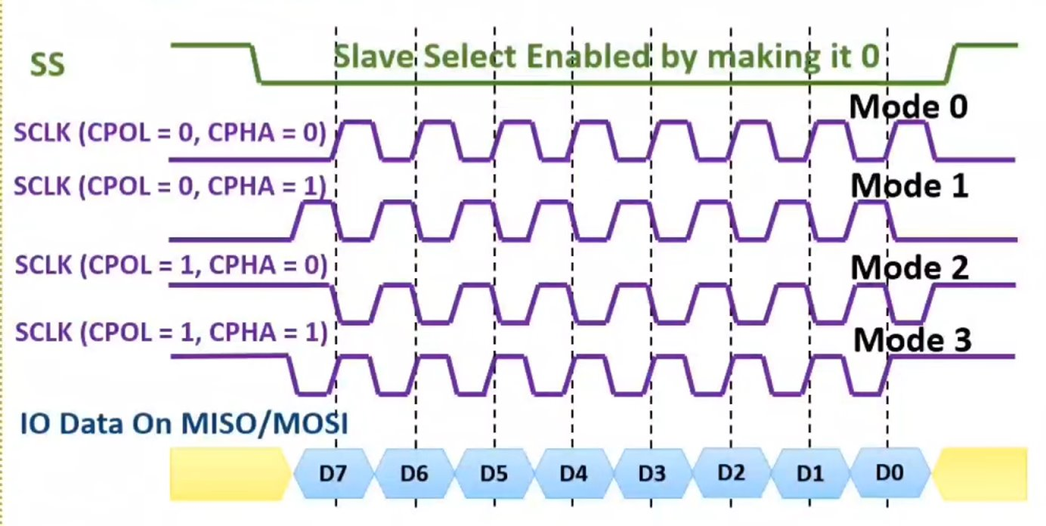
CPOL &CPHA Timing Diagram

Slide 10
Registers Definition
The address listed for each register is the sum of a base address and an address offset.
The base address is defined at the SoC level and the address offset is defined at the module level.
There are 5 registers in SPI
1.SPICR1
2.SPICR2
3.SPIBR
4.SPISR
5.SPIDR

Slide 11
Address | Use
$0 | SPICR1
$1 | SPICR2
$2 | SPIBR
$3 | SPISR
$4 | RESERVED
$5 | SPIDR
$6 | RESERVED

Slide 12
SPICR1
SPIE | SPE | SPTIE | MSTR | CPOL | CPHA | SSOE | LSBFE

Slide 13
SPIE — SPI Interrupt Enable Bit
1 = SPI interrupts enabled
0 = SPI interrupts disabled
SPE — SPI System Enable Bit
1 = SPI enabled, port pins are dedicated to SPI functions
0 = SPI disabled (lower power consumption)
SPTIE — SPI Transmit Interrupt Enable
1 = SPTEF interrupt enabled
0 =SPTEF interrupt disabled

Slide 14
MSTR — SPI Master/Slave Mode Select Bit :
1 = SPI is in Master mode
0 = SPI is in Slave mode
CPOL — SPI Clock Polarity Bit :
1 = Active-low clocks selected. In idle state SCK is high
0 = Active-high clocks selected. In idle state SCK is low
CPHA — SPI Clock Phase Bit :
1 = Sampling of data occurs at even edges (2,4,6,...,16) of the SCK clock
0 = Sampling of data occurs at odd edges (1,3,5,...,15) of the SCK clock

Slide 15
SSOE — Slave Select Output Enable
MODFEN | SSOE | MASTER MODE | SLAVE MODE
0 | 0 | SS not used by SPI | SS input
0 | 1 | SS not used by SPI | SS input
1 | 0 | SS input with MODF feature | SS input
1 | 1 | SS is slave select output | SS input

Slide 16
LSBFE — LSB-First Enable:
This bit does not affect the position of the MSB and LSB in the data register. Reads and writes of the data register always have the MSB in bit 7.
In master mode, a change of this bit will abort a transmission in progress and force the SPI system into idle state.
1 = Data is transferred least significant bit first
0 = Data is transferred most significant bit first

Slide 17
SPICR2
Read | 0 | 0 | 0 | MODFEN | BIDIROE | 0 | SPASWAI | SPC0
write

Slide 18
MODFEN — Mode Fault Enable Bit:
1 = SS port pin with MODF feature
0 = SS port pin is not used by the SPI
BIDIROE — Output enable in the Bidirectional mode enable
1 = Output buffer enabled
0 = Output buffer disabled
SPISWAI — SPI Stop in Wait Mode Bit.
This bit is used for power conservation while in wait mode
1 = Stop SPI clock generation when in wait mode
0 = SPI clock operates normally in wait mode

Slide 19
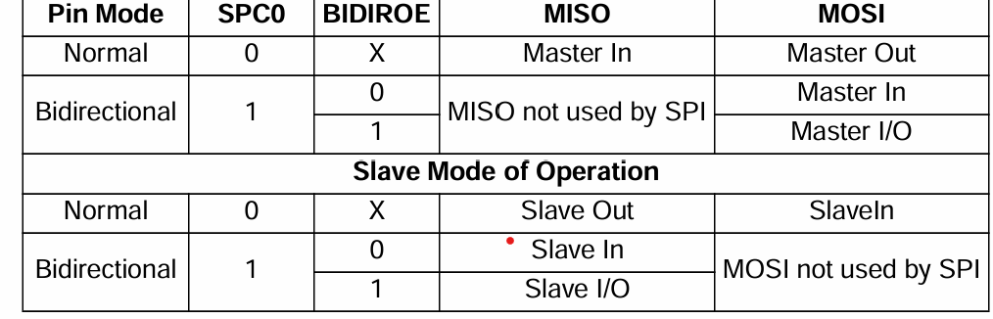
SPC0 — Serial Pin Control Bit 0:
This bit enables bidirectional pin configurations

Slide 20
SPIBR
READ | 0 | SPPR2 | SPPR1 | SPPR0 | 0 | SPR2 | SPR1 | SPR0
WRITE

Slide 21
SPPR2–SPPR0 — SPI Baud Rate Preselection Bits
SPR2–SPR0 — SPI Baud Rate Selection Bits
These bits specify the SPI baud rates . In master mode, a change of these bits will abort a transmission in progress.
The baud rate divisor equation is as follows:
Baud Rate Divisor = (SPPR+1) 2^(SPR+1)
The baud rate can be calculated with the following equation:
Baud Rate =Bus Clock/ Baud RateDivisor

Slide 22
SPISR
Read | SPIF | 0 | SPTEF | MODF | 0 | 0 | 0 | 0
Write

Slide 23
SPIF — SPI Interrupt Flag:
1 = New data copied to SPIDR
0 = Transfer not yet complete
SPTEF — SPI Transmit Empty Interrupt Flag
1 = SPI Data register empty ,New data can be written to SPIDR
0 = SPI Data register not empty,Write operation is not allowed
MODF — Mode Fault Flag:
1 = Mode fault has occurred
0 = Mode fault has not occurred

Slide 24
SPIDR
Read | bit7 | bit6 | bit5 | bit4 | bit3 | bit2 | bit1 | bit0
Write

Slide 25
Single Data Register​
SPIDR acts as both input and output register for SPI data.​
Transmit Operation​
Writing to SPIDR queues one data byte for transmission.​
In Master mode, transmission starts immediately after the previous transfer completes.​
Transmit Ready Indication​
SPTEF flag in SPISR indicates when SPIDR is ready to accept new data.​
Receive Operation​
Received data can be read after SPIF is set and before the next transfer ends.​
Data Loss Condition​
If SPIF is not serviced before the next transfers complete,​
new data bytes are lost, and SPIDR retains only the first unread byte.​
​

Slide 26
SPI Modes of Operation
SPI can be operated in 3 modes
1.RUN Mode
2.WAIT Mode
3.STOP Mode
Run Mode (Normal Mode)​
SPI works normally​
Clock is ON​
Data transmission and reception occur as usual​
Used during regular operation​

Slide 27
Wait Mode (Low-Power but Smart Mode)​
Wait mode behavior depends on SPISWAI bit.​
If SPISWAI = 0, SPI behaves exactly like Run Mode, No power saving.​
If SPISWAI = 1, SPI clock generation is turned OFF to save power.​
Master Mode​
Ongoing transmission pauses​
Transmission resumes when CPU returns to Run Mode​
Slave Mode​
SPI continues receiving and transmitting​
This keeps the slave synchronized with the master​

Slide 28
Stop Mode (Deep Sleep Mode)​
Maximum power saving​
Master: Transmission stops, resumes in Run Mode​
Slave: Completes current byte and maintains synchronization​

Slide 29


